Slide 1

Insights
Module 1 Week-3

Slide 2
Agenda
Structural Pattern : Adapter Pattern
Behavioural Pattern : Observer Pattern

Slide 3
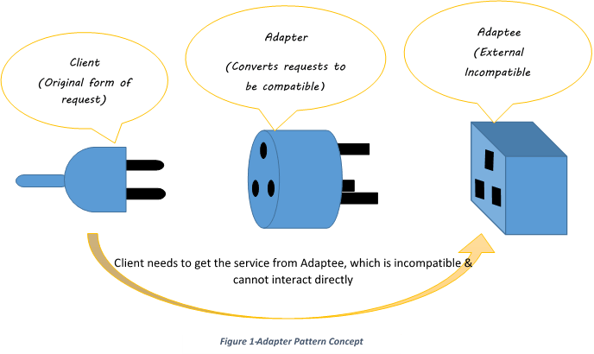
Adapter Pattern

Slide 4
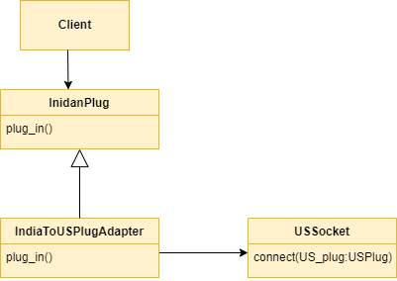
Code Walkthrough - Plug Adapter Example

Slide 5
Practical View

Slide 6
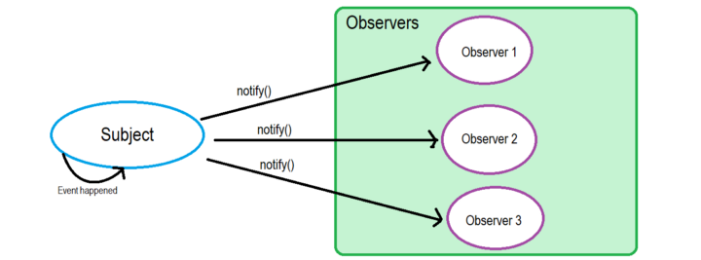
Observer Pattern
Notes:
Observable == Subject
Observers

Slide 7
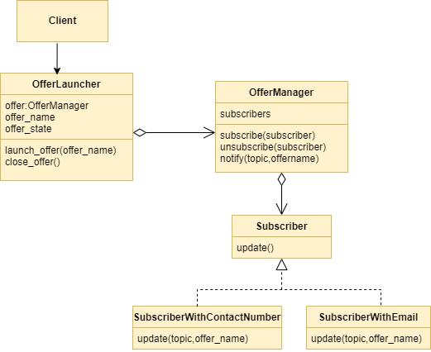
Code Walkthrough - Shopping Portal Example

Slide 8
Practical View
Notes:
UI Applications uses Observer Pattern for Managing the State of across different components.

Slide 9
Machine Setup
PyCharm and MySQL
- mysql-connector
- pymongo
Notes:
UI Applications uses Observer Pattern for Managing the State of across different components.

Slide 10
References
https://codeburst.io/observer-pattern-how-can-it-be-used-to-build-a-simple-web-app-651d92d942f5
https://github.com/junit-team/junit5 - https://github.com/junit-team/junit5/tree/main/junit-jupiter-engine/src/main/java/org/junit/jupiter/engine/discovery
https://github.com/iluwatar/java-design-patterns
https://refactoring.guru/design-patterns/catalog
https://github.com/faif/python-patterns

